Slide 1
Job Hunt – Finding a Desirable Job based on LinkedIn Data
SEIS 763 Final Project

Slide 2
Objectives
Hypothesis: there are differences in salaries among all factors
Hard skills
Locations (eg. regions, states & economic level)
Industries
Companies
What are the trends in data-related jobs?
Where I should move to?
What skills is demanding?

Slide 3
INTRODUCTION- Dataset & Data Cleaning
ML final project data cleaning PART 1.ipynb
ML final project data cleaning PART 2.ipynb
ML final project data cleaning PART 3 nlp.ipynb
ML final project data cleaning PART 4.ipynb
ML final project data cleaning PART 5.ipynb
'LinkedIn Job Postings (2023 - 2024)’
1
124,000 x 33
Basic Data Cleaning
2
32,556 x 19
Only full-time jobs
Drop inrellevent columns
Calculate all hourly salarty into yeaarly
Data Merging
3
32,556 x 40
Merging company profiles data
Merging economic level (gdp& mean income)
Merging Sector&industry
NLP Keywords Extracting
4
5,958 x 44
Extracting data related job by extract data related Keywords from job job description and job title.
Calculate score for each skillset.
Industry sector simplification.
Keep only data_related job postings
Futher Cleaning
5
3908 x 22
Drop rows with too many missing values
Select columns that could be used in our project

Slide 4
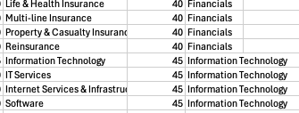
NLP Keywords Extractions
["python", "java", "c++", "r", "sql", "javascript","matlab"]
is_data _related
programming_
languages_score
["excel", "tableau", "statistics", "sas", "spss","regression","decision tree","predictive analysis", "statistics","statistical",'models’]
["bachelor", "undergraduate","4 year”, "master", "postgraduate", "phd", "doctorate","mba"]
["data"]
degree_
level
analysis_statistics_score
165 Industry classifications
industry_
Sector
machine_learning_score
["tensorflow", "keras", "scikit-learn", "pytorch", "deep learning","nlp","svm", "clustering","natural language","machine learning", "deeep learning","ai"]
cloud_platform_score
data_visualization_score
["dataset","mysql", "postgresql","mongodb", "oracle","sql","database","query"]
New Columns
["power bi", "matplotlib", "seaborn", "dash","tableau","cognos",'bi']

Slide 5
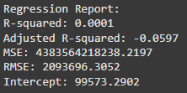
Basic Linear Regression
Started by selecting a handful of predictors that we thought would make sense to help estimate potential salary.
Degree Level
Employee Count
Industry
Work Type
Our inclinations were incorrect as displayed in the regression report

Slide 6
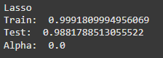
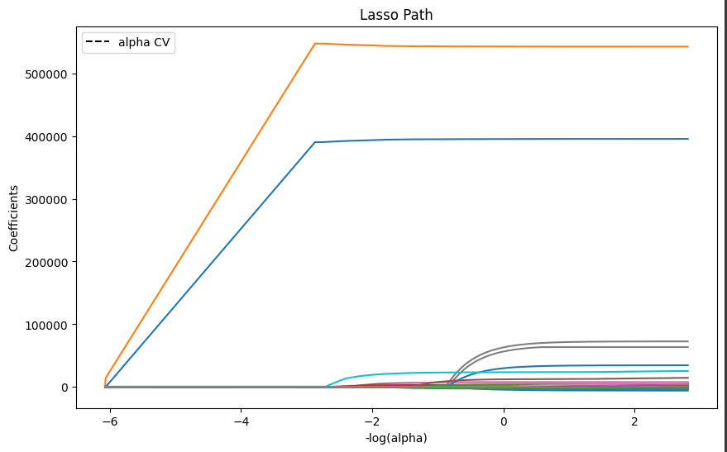
Regression With Lasso
Next we conducted Lasso Regression analysis.
Our R2 values for both the train and test were excellent.
We can quickly see that two predictors stand above the rest.

Slide 7
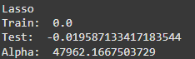
Further Inspection
Our two variables were min/max salary.
This is possibly problematic as our dependent variable is essentially created from these two variables.
Once we dropped those values our model fell apart.

Slide 8
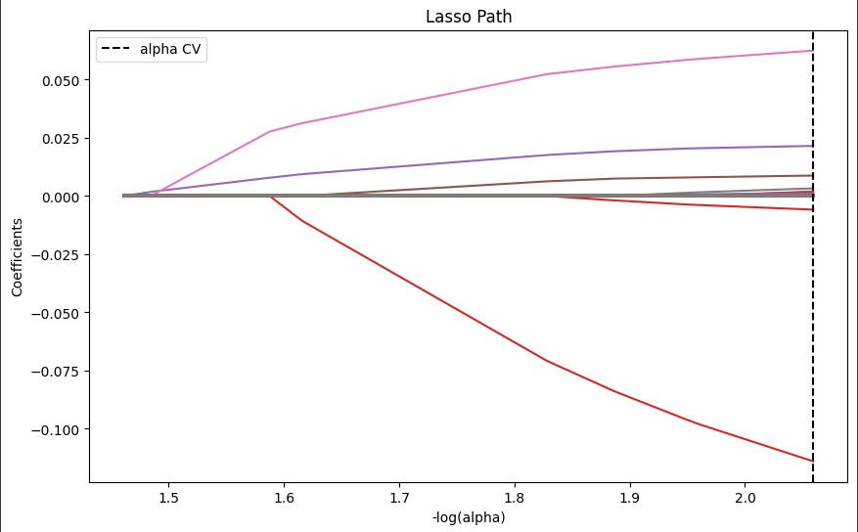
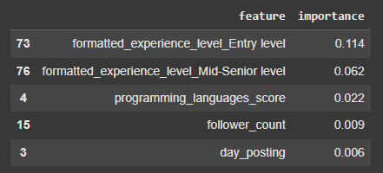
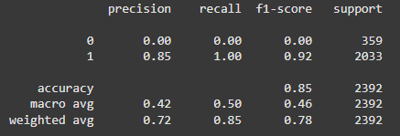
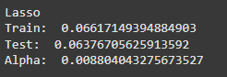
Logistic Analysis
Since the model fell apart if we excluded min/max salary, we wanted to try a different approach.
Instead, we wanted to try and create a model that could tell us our likelihood of making over $60,000.

Slide 9
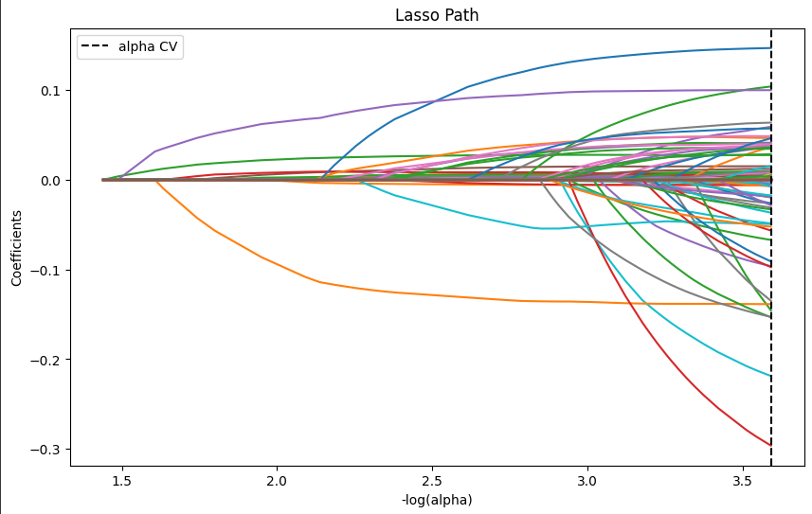
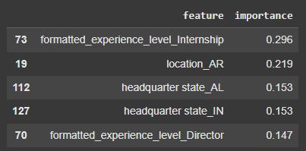
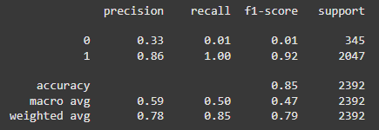
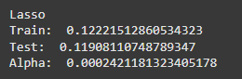
Logistic Continued
Interestingly, dropping min/max salary like we did before actually improved our model.

Slide 10
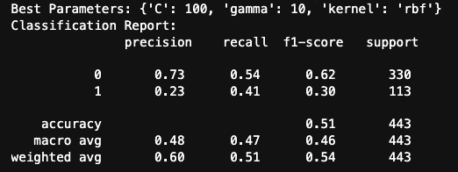
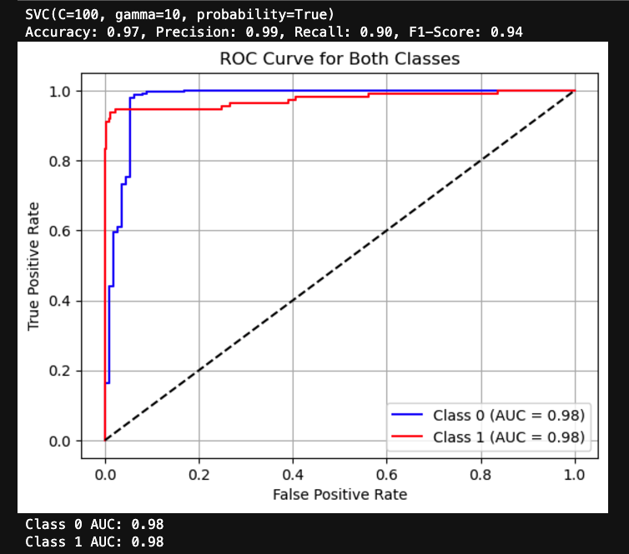
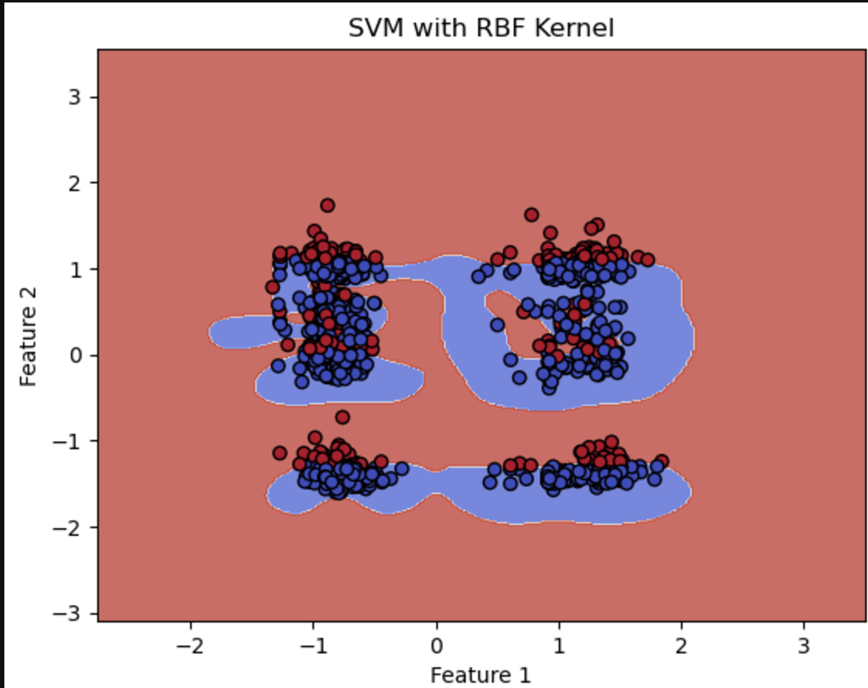
SVM Model 1 with PCA features (best lambda& C tested)
Predict <140K vs. >140K
F.Y.I
140k is the 3rd quantile
100k is the median

Slide 11
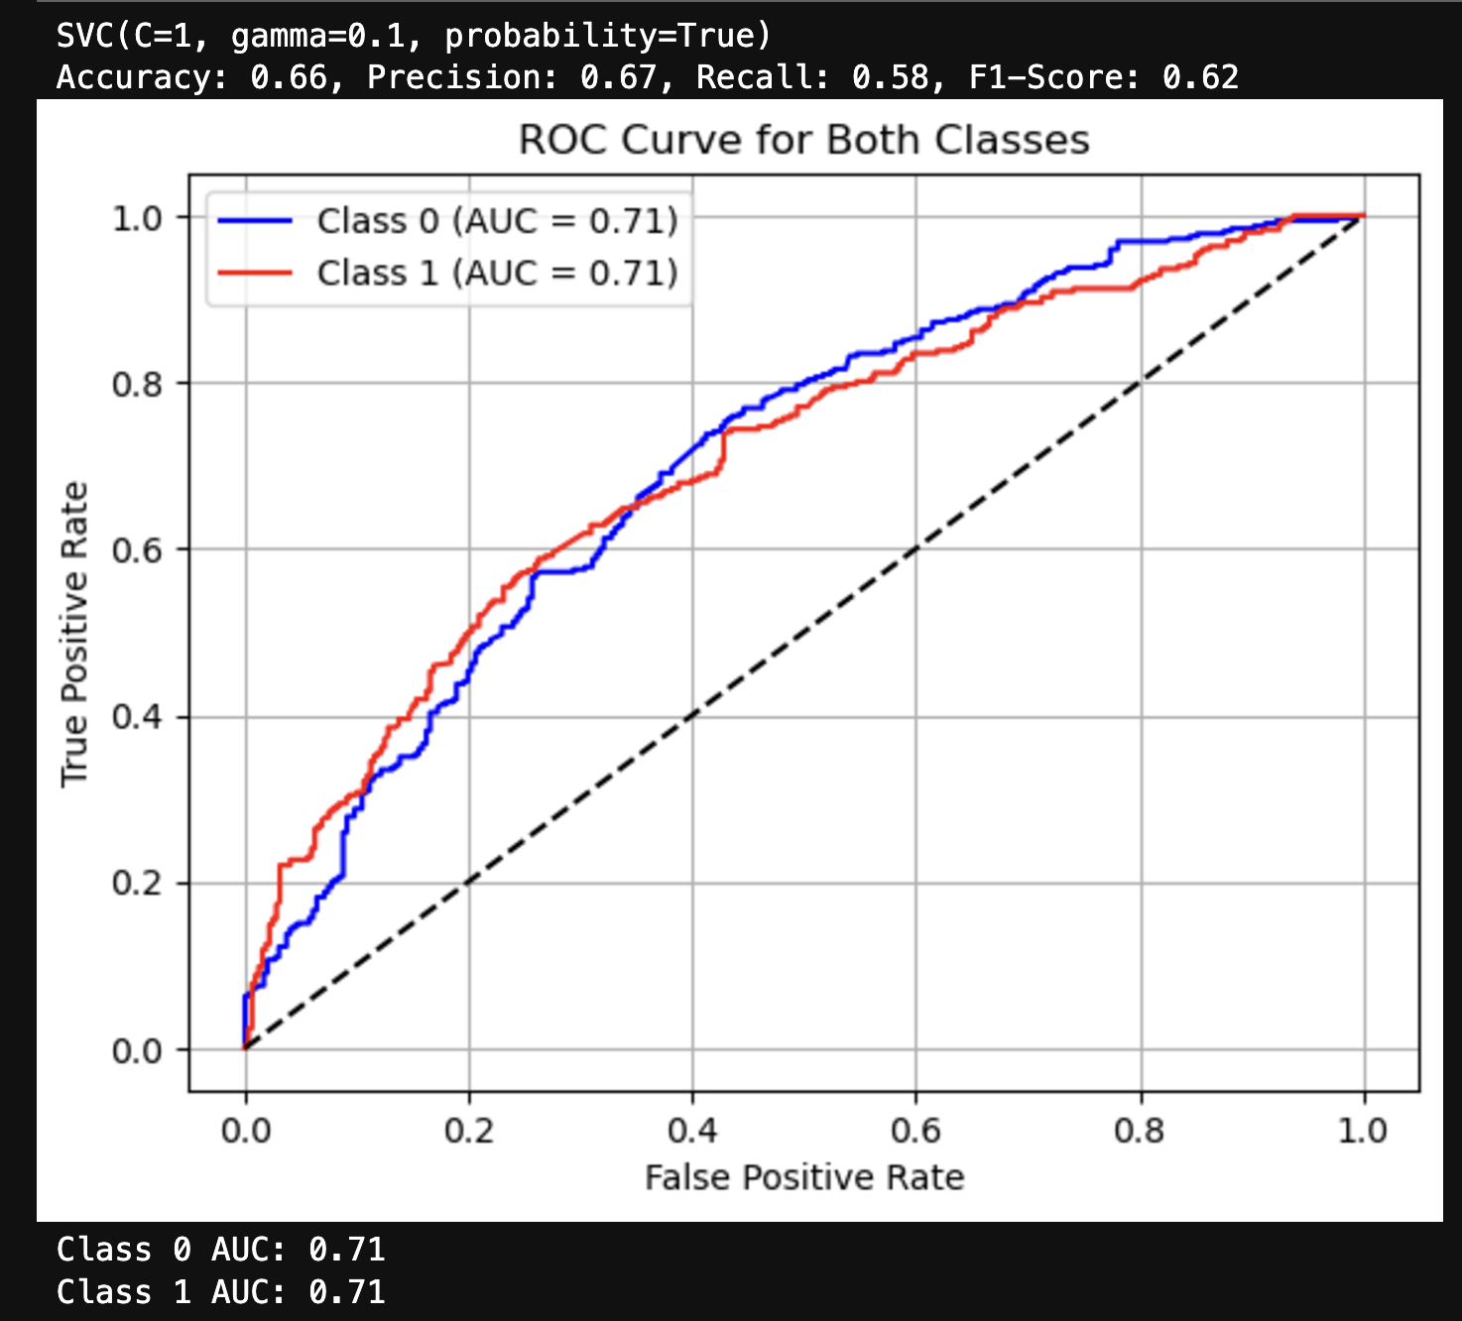
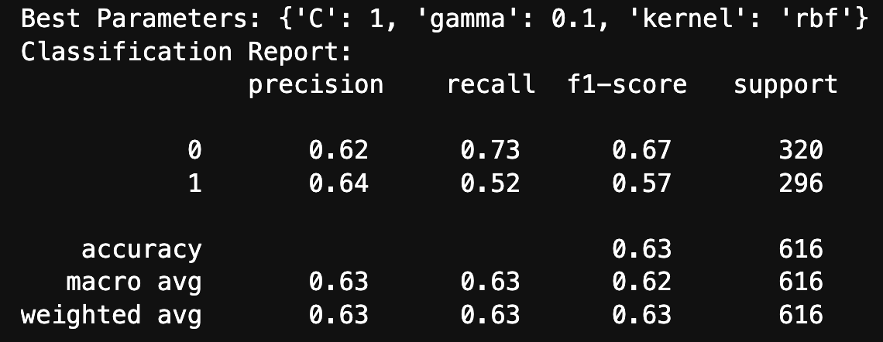
SVM Model 2 with Top 5 Predictors
company_score
economic_score
company_size
programming_languages_score
job_classification_Engineering

Slide 12
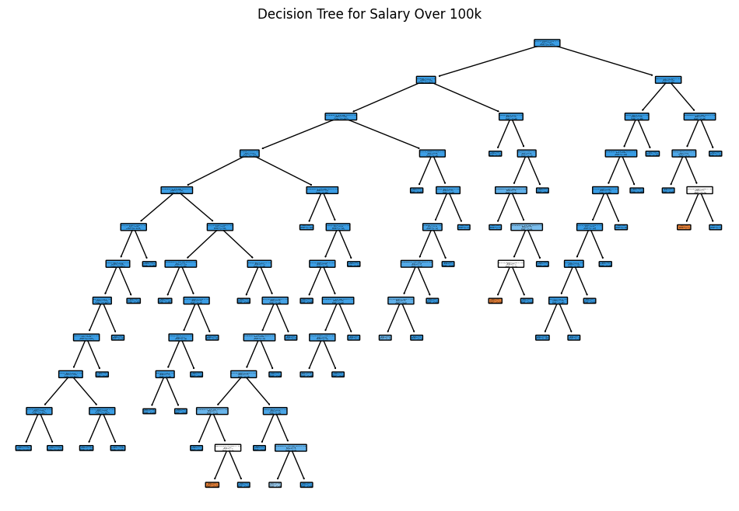
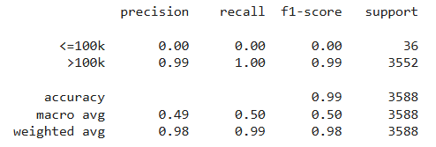
Decision Tree – Predicting Salary over $100k
Precision, Recall, and f1-Score: Great at predicting salaries over $100k
Less accurate for salaries under $100k, due to smaller sample size in dataset
Root Nodes:
analysis_statistics_score
database_score
machine_learning_score

Slide 13
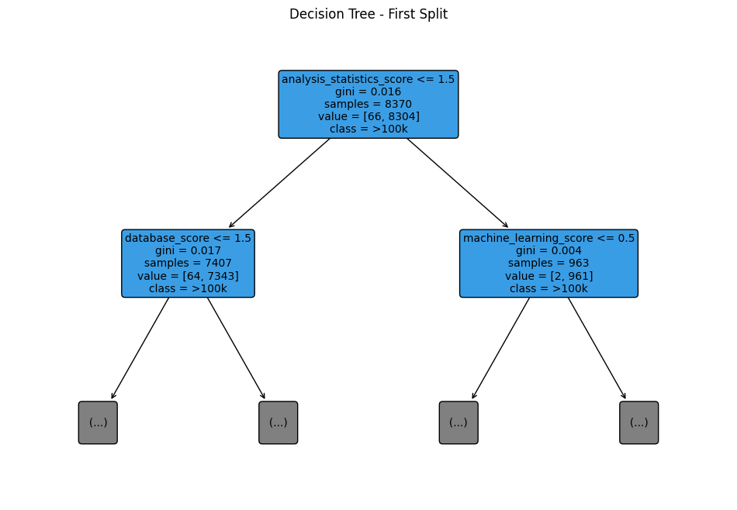
Decision Tree – Root Node Analysis
Root Node Decision: Having an analysis_statistics_score less than or equal to 1.5
Higher Analysis Score: Database score then needs to be less than or equal to 1.5
Lower Analysis Score: Machine learning score then needs to be less than or equal to 0.5

Slide 14
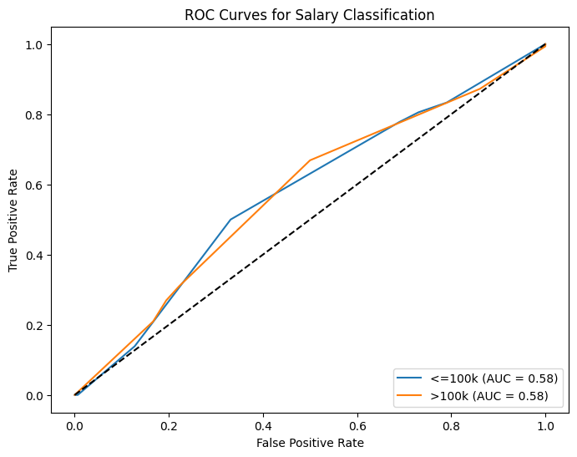
Decision Tree – Validation
<=100k: AUC of 0.58, performing slightly better than a coin flip
> 100k: AUC of 0.58, performing slightly better than a coin flip
Accuracy: (3549+0)/(3549+0+36+3) = 98.9% accuracy, with bias to class I
Confusion Matrix | False | True
False | 0 | 36
True | 3 | 3549

Slide 15
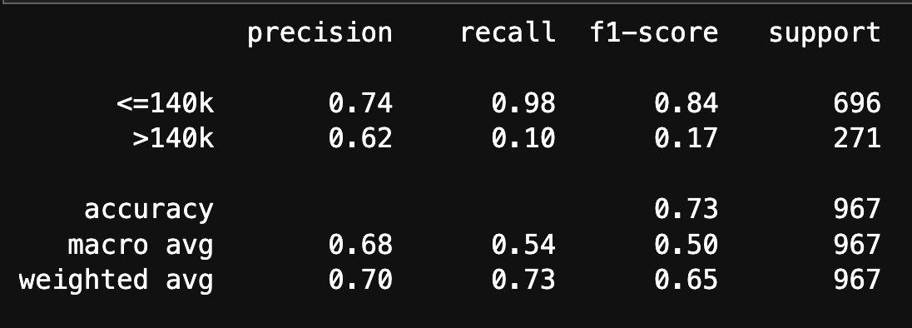
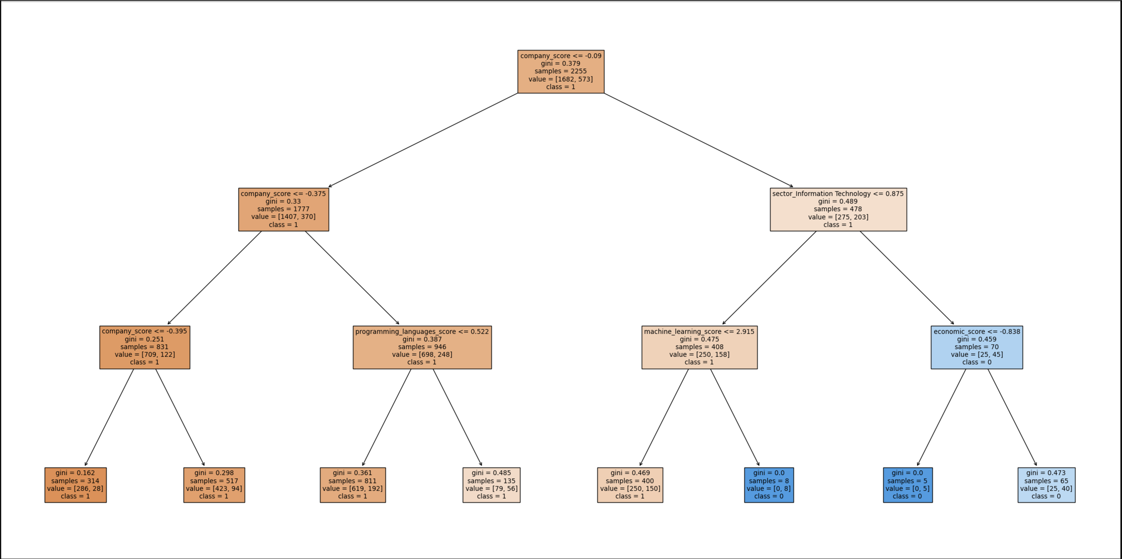
DT Model2- 140k Predicting
company_score
job_classification_Engineering
programming_languages_score
sector_Information Technology
machine_learning_score
economic_score

Slide 16
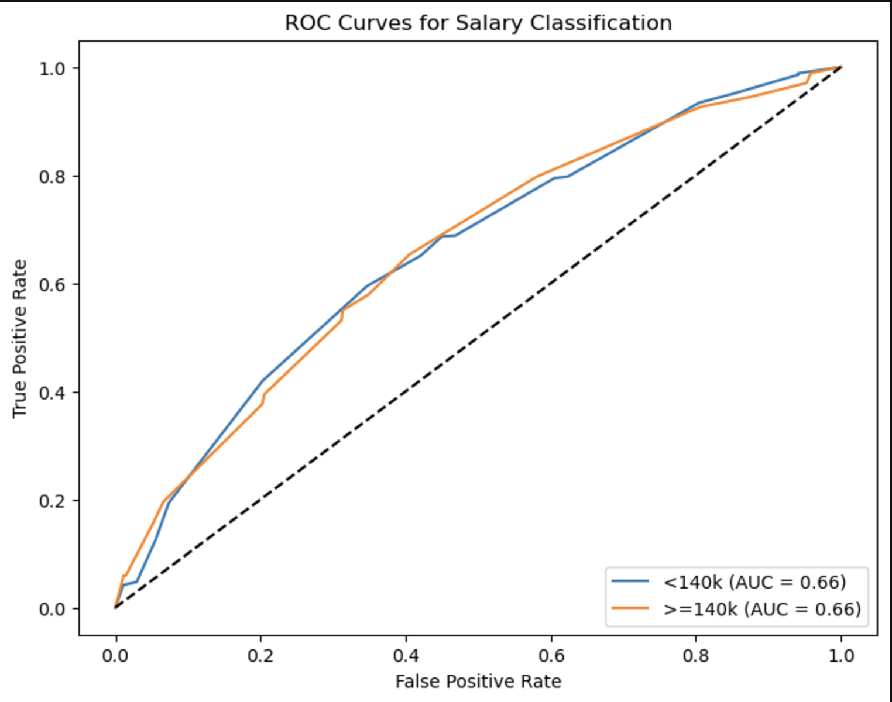

Slide 17
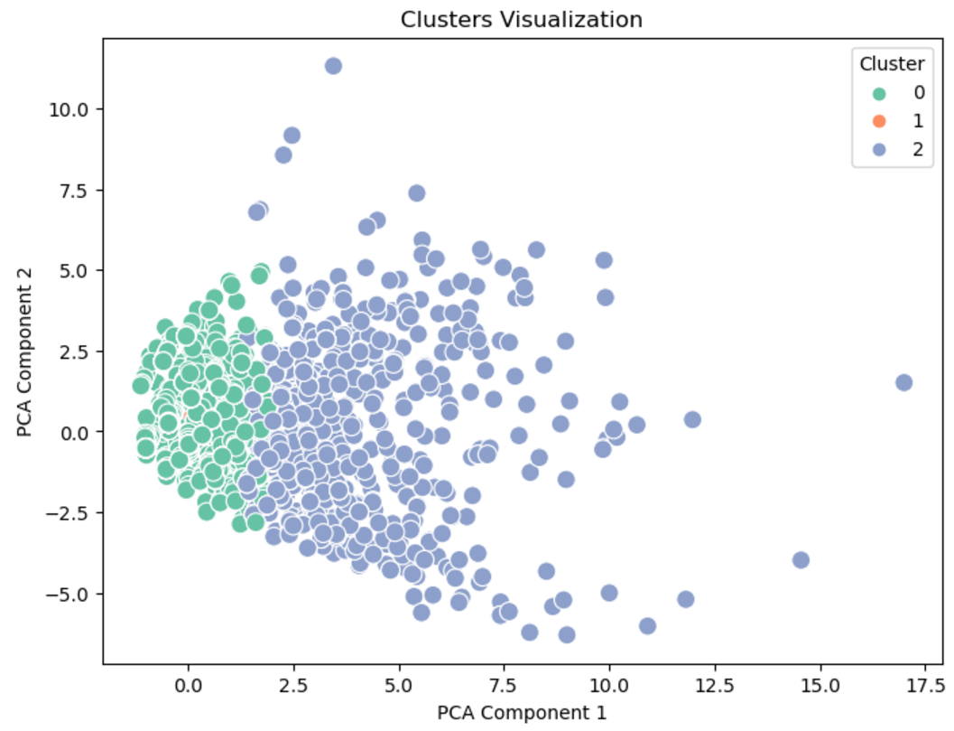
Clustering Analysis – Overview
Clustering Analysis of Job Market Trends for Data Majors
Clustering Methods Used:
K-Means: 3 clusters based on salary, views, skills, and job duration.
Hierarchical Clustering: Explored relationships between clusters using a dendrogram.
DBSCAN: Identified dense regions, noise points, and smaller clusters.
Key Insights:
K-Means:
Cluster 0: Moderate salary, balanced skills.
Cluster 1: Extremely high salary, minimal skills.
Cluster 2: Low salary, high advanced skills (e.g., ML, data visualization).
Silhouette Score (K-Means): 0.601 (indicates good separation).

Slide 18
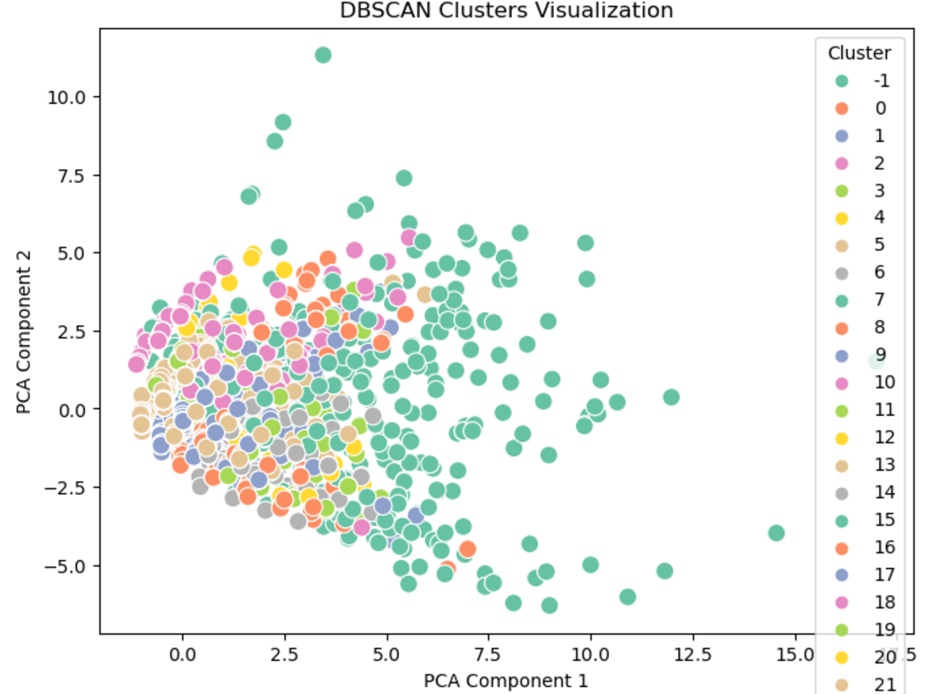
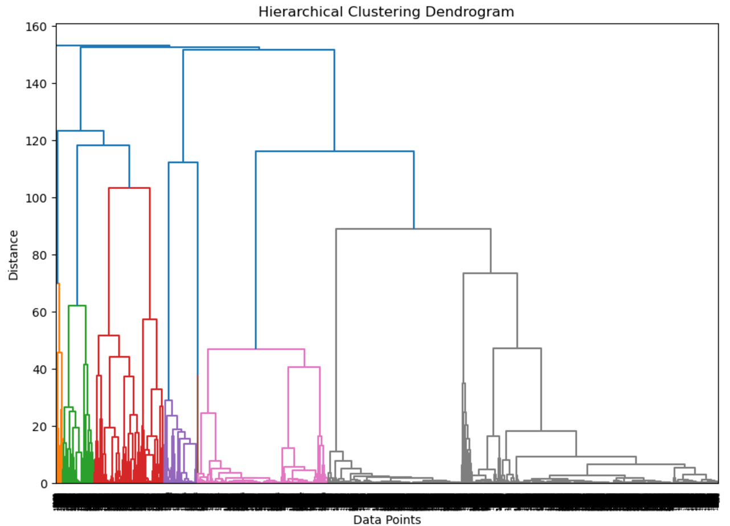
Clustering Analysis – Results
Detailed Results of Clustering Approaches
Clustering Highlights:
K-Means:
Distinct clusters with clear differences in salary and skill requirements.
Hierarchical Clustering:
Dendrogram shows relationships between clusters (e.g., Clusters 0 and 2 are more similar; Cluster 1 is an outlier).
DBSCAN:
30 clusters and one noise group (-1).
Detects niche job roles and unique postings.

Slide 19
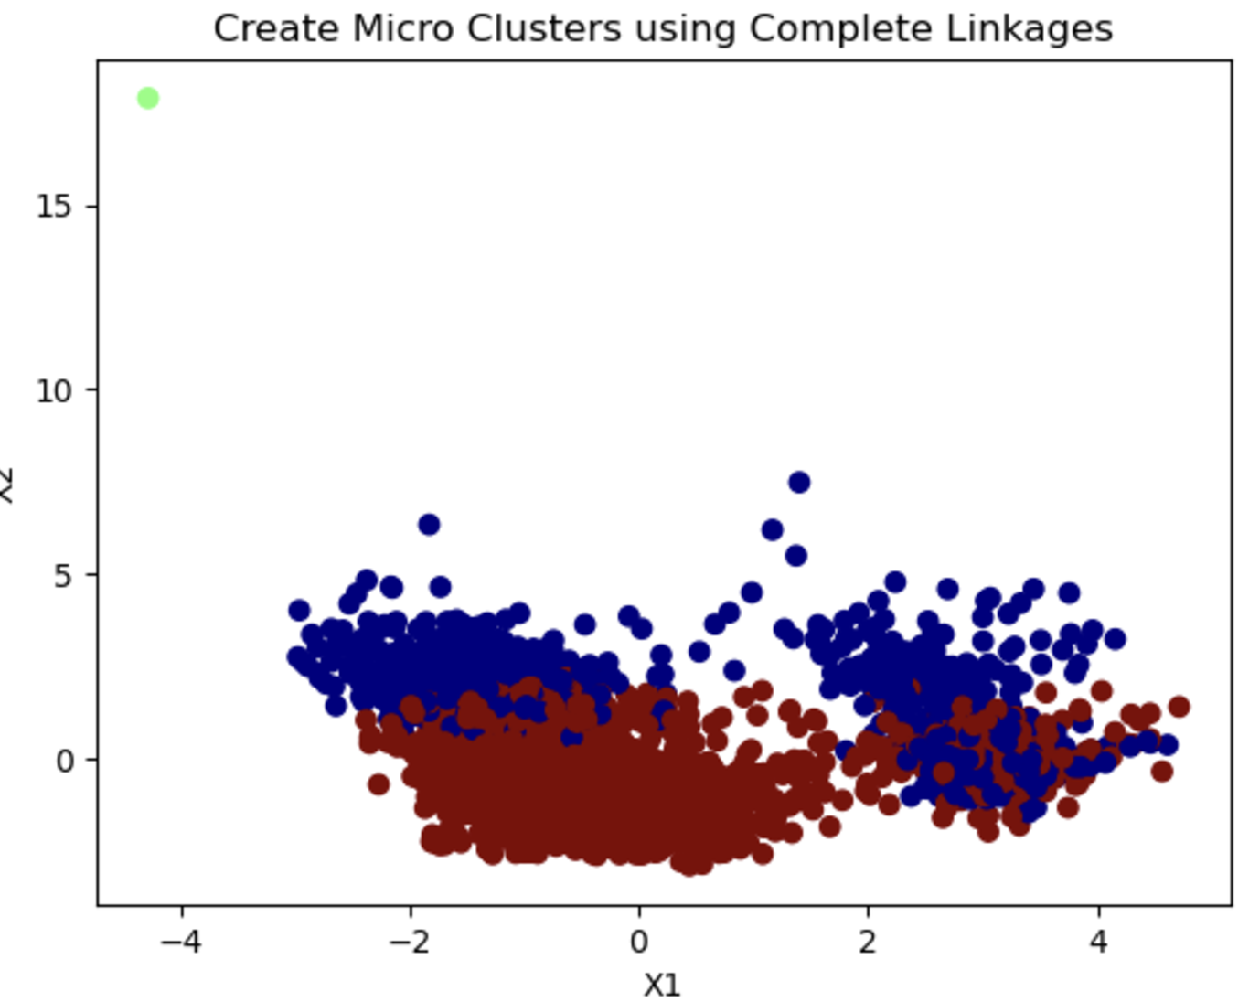
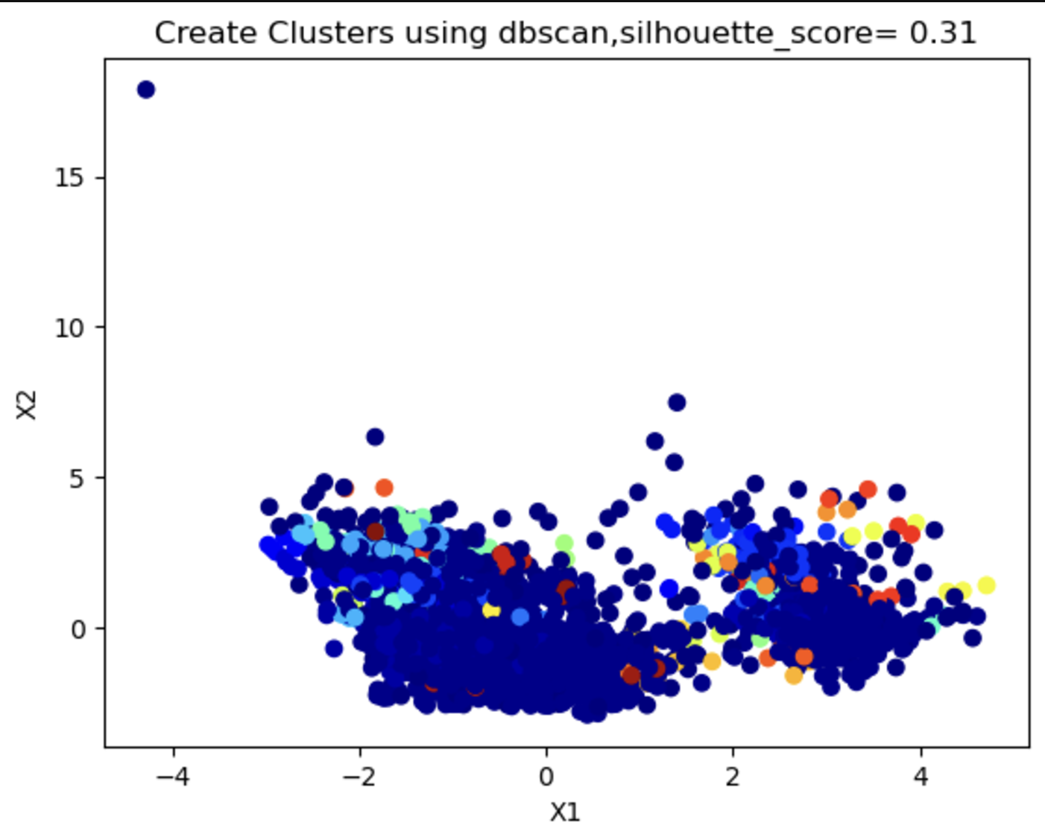
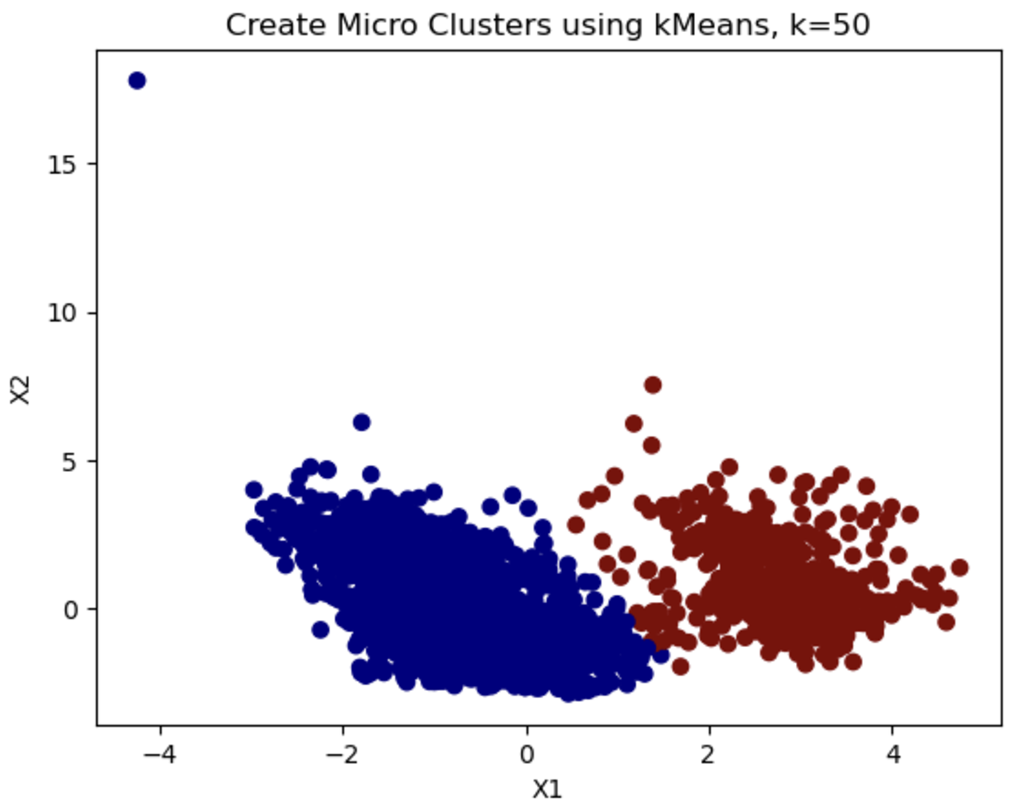
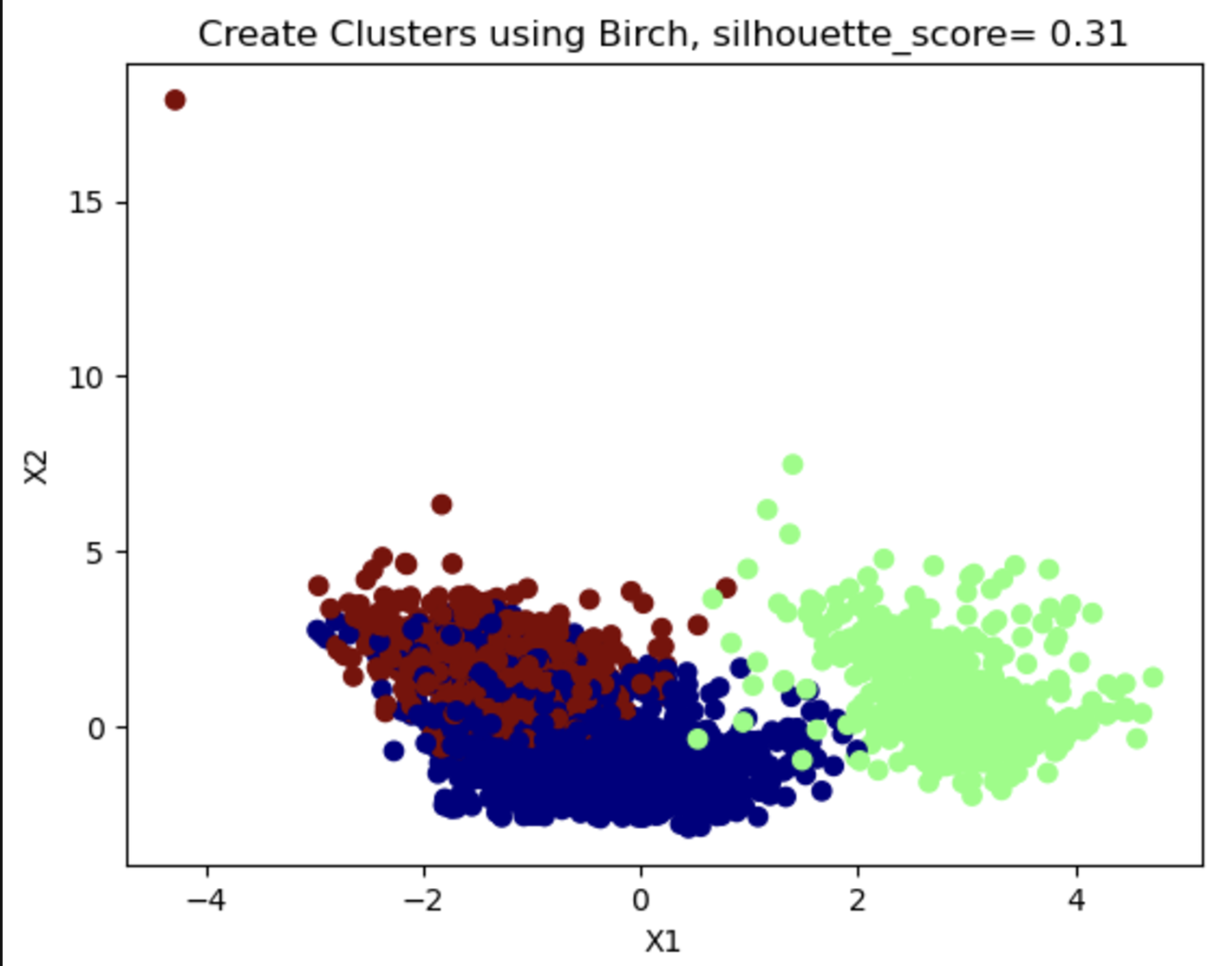
Clustering Model 2: PCA & K-means
Silhouette score=0.552

Slide 20
Summary
Linear Regression & logistic Models
Linear relationship is weak, which means the salary could not be predicted through regression models.
SVM & Decision Tree Models
Key predictors to predict salaries 140k or more:
Company
Job location
IT industry
Engineering position
Machine learning skills
Decision Tree Models
Key predictors to salaries 100k or more
Analysis statistics score
Database score
Machine learning score
Clustering Models
Data Crew: Moderate salary, balanced skills.
Ones who born in Rome: Extremely high salary, minimal skills.
Wage Theft : Low salary, high advanced skills (e.g., ML, data visualization).
Thank You!
Q&A

